Slide 1

Research Update
By: Helder Rebelo

Slide 2
About Me
Current Senior in Mechanical Engineering
Currently in the MS/BS NJIT Program
Currently a Process Engineer at CMC Steel
Have been conducting research with Professor Xing since January 2025

Slide 3

Where We Started
My goal was to computationally replicate the findings from the article "Three-dimensional architected materials and structures" by Greer and Deshpande.
Using the equation above, and the expected values of N=3 and A=1.5, based off research the article had conducted, I was able to confirm the results of my simulation.

Slide 4
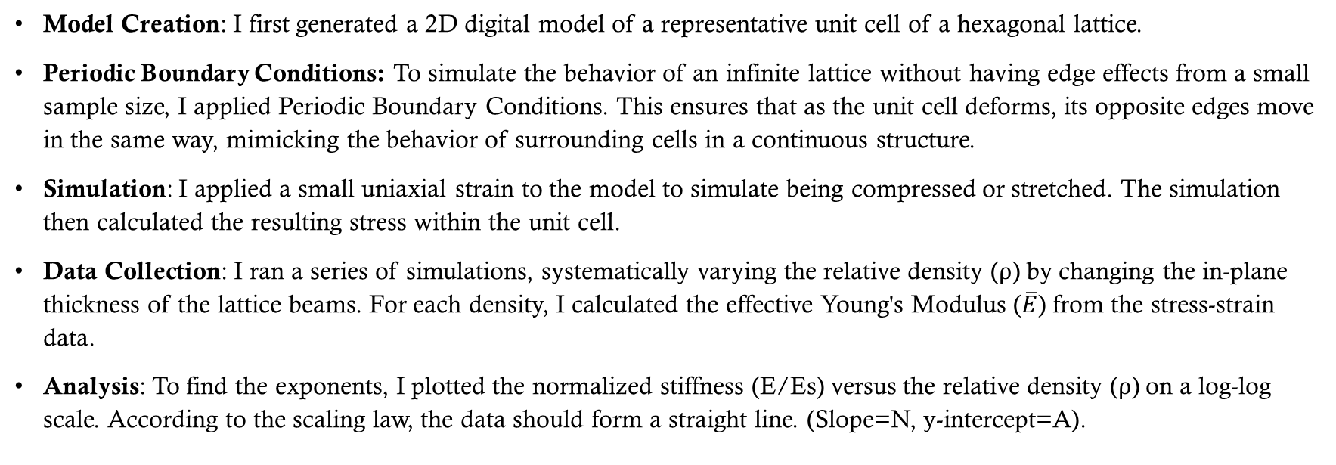
Where We Started Cont.
Model Creation: I first generated a 2D digital model of a representative unit cell of a hexagonal lattice.
Periodic Boundary Conditions: To simulate the behavior of an infinite lattice without having edge effects from a small sample size, I applied Periodic Boundary Conditions. This ensures that as the unit cell deforms, its opposite edges move in the same way, mimicking the behavior of surrounding cells in a continuous structure.
Simulation: I applied a small uniaxial strain to the model to simulate being compressed or stretched. The simulation then calculated the resulting stress within the unit cell.
Data Collection: I ran a series of simulations, systematically varying the relative density (ρ​) by changing the in-plane thickness of the lattice beams. For each density, I calculated the effective Young's Modulus ($\overline{E}$) from the stress-strain data.
Analysis: To find the exponents, I plotted the normalized stiffness (E/Es​) versus the relative density (ρ​) on a log-log scale. According to the scaling law, the data should form a straight line. (Slope=N, y-intercept=A).

Slide 5
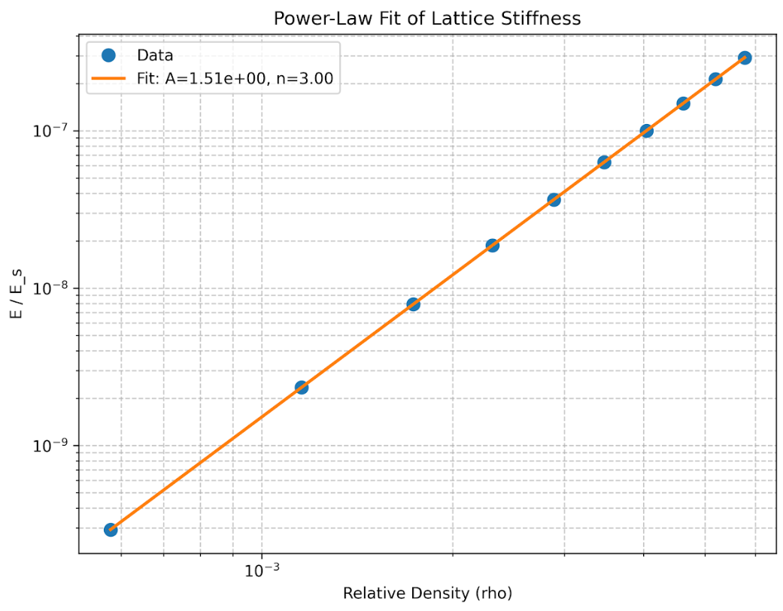
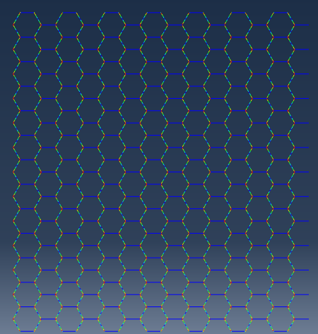
Results

Slide 6
Crack Propagation
Background & Objective: We are investigating the fracture mechanics of a 2D hexagonal lattice, a bending-dominated architected metamaterial. As classical fracture theory is insufficient for such discrete structures, our objective is to computationally determine its fracture toughness by simulating crack propagation, following the framework of Shaikeea & Deshpande (2022).
Mode I Simulation (Tensile): To determine the tensile fracture toughness (KIc​), a Mode I loading condition will be simulated. This involves applying a uniform vertical displacement to the top boundary while the bottom boundary is fully constrained, placing the pre-crack under a pure tensile stress field.
Mode II Simulation (Shear): To find the in-plane shear toughness (KIIc​), a Mode II condition will be simulated. This is achieved by applying a uniform horizontal displacement to the top boundary, with the bottom boundary fixed, inducing a shear stress state across the crack plane.
Data Colection: The simulation will identify the far-field stress (σ ∞​ ) at the critical point of first strut failure at the crack tip. The fracture toughness will then be calculated using the LEFM relation.
Validation Against Theory: The simulation will be run for multiple relative densities (ρ​) to generate a series of toughness values. We will validate our results against the article's scaling law (KIc​ ∝ ρ​^3/2) by plotting the data on a log-log scale, which should yield a linear fit with a slope of approximately 1.5.

Slide 7
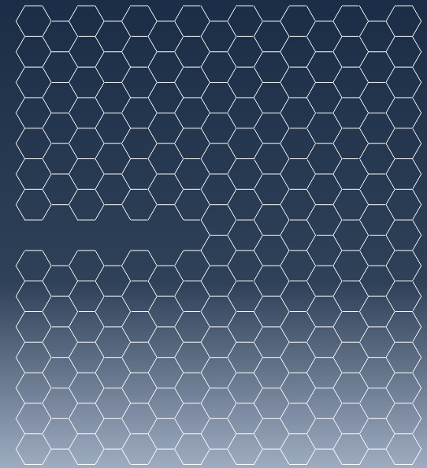
Modes of simulation
Mode I
Mode II

Slide 8
Why this is important
Medical Implants and Braces: We can 3D print custom hip implants, spinal cages, and bone grafts with an internal architecture that mimics human bone. This makes them lightweight, strong, and encourages the patient's own bone to grow into the implant for a better, more permanent bond. The designed toughness is critical to ensure the implant never fails under the stress of daily life.
Protective Gear and Helmets: The ability of these structures to crush in a controlled way makes them perfect for absorbing energy from impacts. This research enables the design of next-generation helmets, body armor, and vehicle bumpers that are far lighter and more effective at protecting a person or a vehicle from a collision or projectile.
Robotics and High-Performance Machines: Lightweighting is crucial for robots. Lighter robotic arms can move faster, be more precise, and use less energy. The engineered toughness also means they can better withstand accidental collisions or the stresses of repetitive, high-speed tasks.

Slide 9
Thank you all

